Slide 1
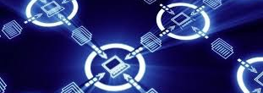
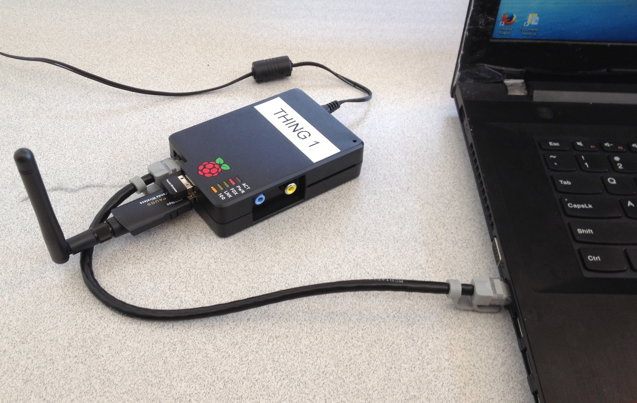
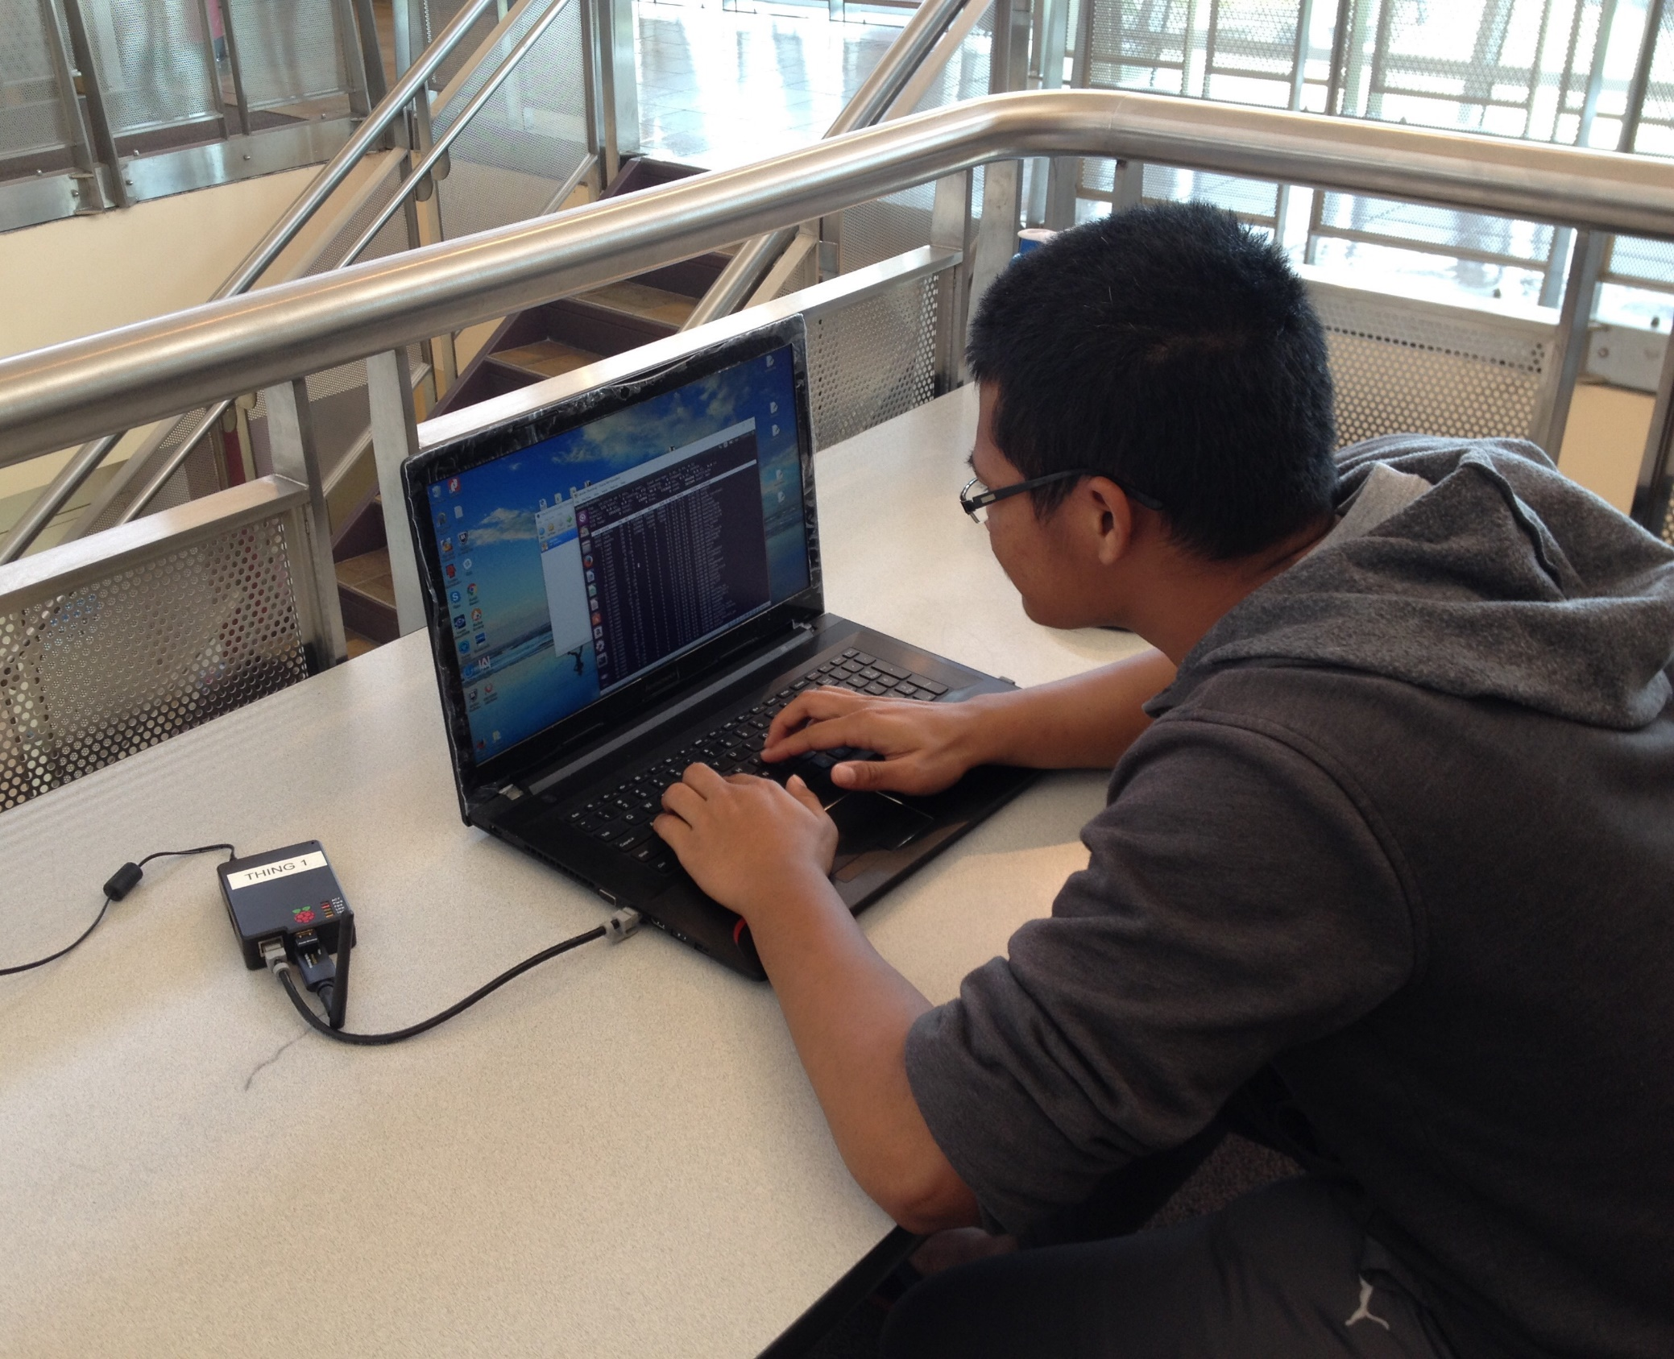
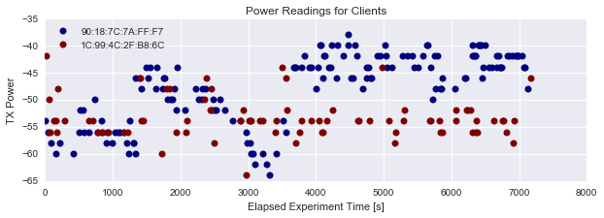
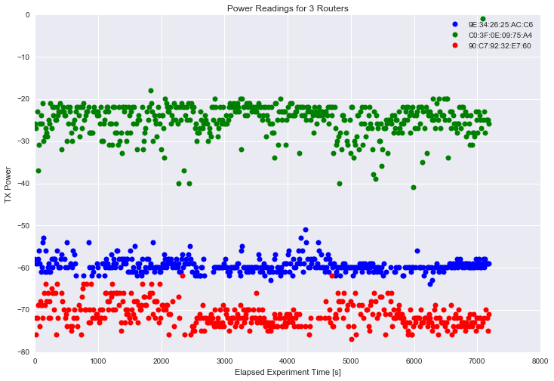

Wifi Sensor Networks for Internet of Things Data
Vecheka Chhourn, Jun Wang, Dr. Charles Reid
Design Problem
Procedure
Results / Data
The goal of our project was to design a data pipeline for storing and analyzing data from a sensor network. The sensor network consisted of Raspberry Pi microcomputers and Wifi cards as sensors. The sensors gave us many kinds of information: signal strength, bandwidth, time in area, and MAC address. We can also gather information about kinds of hardware. By storing the data in a database, we can use with data analysis tools.
It is an example of passive listening, which demonstrates the information available simply by listening passively to wireless signals.
We ran field experiments to test the data pipeline system, by placing the Raspberry Pis in high-traffic areas on campus to check for wireless activity. We were able to collect information like:
Wireless network names - the names of different wireless networks in the area
Signal strength - how weak the wireless signal is
Speed - the rate of packet and data transfer between routers and devices
Duration - we were able to see nearby devices and computers, and when they first showed up or were last seen
MAC Address - all wireless packets contain the MAC address of the source and destination, in the clear. The MAC address is like a fingerprint and is useful for tagging devices or looking up the manufacturer of a device.
We used the aircrack-ng program to gather wireless data into CSV (comma-separated variable) files. We then used Python to convert the CSV file to SQL (structured query language), and stored the SQL data in a SQLite database.
About the Project
What is the Internet of Things?
As sensors decrease in size, cost, and power, more and more sensors are being used to generate big data sets – a concept called the Internet of Things.
Why data?
Data sets from sensors must be analyzed to extract meaningful information from it. As a result, programming tools for analyzing large data sets from sensor networks are important.
What is the pipeline?
Our project is based on the idea of building a data pipeline for the Internet of Things. The purpose of our research project was to construct a sensor network and store data from the sensor network to enable analysis of data. The sensors were low-cost and low-power microcomputers, in our case, Raspberry Pis. The sensors gathered information about wireless network signals over several days. These were stored in the database for analysis.
Why gather sensor data?
The concept of gathering big data sets from sensor networks and performing data analysis has many applications, like optimization and prediction, wireless security, and climate science. Data pipelines enable data analysis at different time scales: from seconds, days, or years. Designing tools for sensor network data is important, given how common and how powerful sensors are.
Step 1: Deploy the Raspberry Pi sensors to collect the wireless network data.
Discussion
This design project incorporated a lot of different kinds of technologies. It was important to understand some things for the data pipeline to be successful:
How wireless radio signals work
How to collect wireless data from Linux
How to construct and use an SQL table
How to load wireless data into Python to clean it and put it in an SQL database
The most exciting part of the project was when the data pipeline concepts helped to understand complicated wireless systems like Google Maps and Uber app.
Components of the Data Pipeline
Step 2: The sensor network operator uses the software aircrack-ng to gather sensor data, and uses Python and SQL to processes and store the data.
Wireless Sensor
Python Code
CSV → SQL
Conclusion
Wireless Sensor
Nearby
Router
From our experiments with the data pipeline design, we learned several things:
Computers, laptops, and mobile devices broadcast a lot of information
Wireless signal strengths can be very random, but with lots of sensors and lots of data, it is possible to physically locate a device (see figure on left)
A sensor network can look for specific devices to appear or disappear
Wireless sensors are very cheap and are used in many other networks (automobiles, airplanes, manufacturing, weather data). We can collect and analyze data for these kinds of systems using the same hardware and software. This gives us a better understanding of the world.
Wireless Sensor
Distant
Router
SQLite Database
Step 3: Analyze the data in the SQL database using Python data analysis libraries.
This research was funded through the Seattle College RST Academy and NSF S-STEP grant #0969609.

